Slide 1
ASICS : chasing a 2020 vision
Name – Megha Bisht
Date: 07.11.22

Slide 2
Appendix
Introduction -------------------------------- 03
Market Analysis (5C, VRIO, 6 forces) ---------- 04
Positioning ----------------------------------11
Part – B (Recapture changes)
4. Target audience ------------------------------ 16
5. Positioning ----------------------------------- 18
6. Product Category ----------------------------- 23
7. Recapture decisions --------------------------- 25
8. Evaluation (2022)------------------------------ 26

Slide 3

ASICS then & NOW (brief OVERVIEW)
THEN : The market and Asics
The go to brand for serious runners
Participated in Marathons where 50% wore Asics shoes
Runners loving the functionality of Asics
NOW : The market and Asics
A sharp decrease in marathon participation
A growing trend where casual/fun runners are growing
Growing interest towards stylish shoes, and less focus on quality, technology and functionality

Slide 4
Goals Today
Goals For the Future
Integrate Run keeper with ASICS
Set a consistent communication message
5 years to increase revenue with operating income
10% of total sales
Find ways to expand to broader audience
Offer solutions that will cater to the needs and desires
Of consumers
Improve data on consumer through Runkeeper integration to
Improve ASCIS product offerings
Establish min 60 brand stores around the world each year
Grow profit
Shift with the trend
Improve sales In the overseas market
Improve brand awareness
Maintain the long-standing reputation
Use our strength to maintain relation with
Core consumers
Producing innovative ideas to use
in future products
Gather information on consumers to understand
Future goals for ASICS
Keep researching to keep ourselves ahead of all the competition
OO
Objectives
Customers - Offer solutions to fit their needs improves their performance while giving comfort
Employees - Provide areas for growth and learning opportunities
Owners – Ensure revenue growth and business expansion in various parts of the world
Government – Ensure all the actions taken by the firm aligns with the country rule and regulation

Slide 5
Why are we here?
The dynamics of the modern world are shifting in the area of sportswear. There is severe rivalry in the market, and as the strength of the market giants increases, there is a continual desire for innovation. The market poses one question, "What do you have to offer?"
Despite being a fierce competitor in the market, ASICS finds it difficult to establish itself in the new consumers minds. The company's vision is to successfully integrate with the fitness keeper Runkeeper app in order to establish a strong brand in the market that appeals to consumers while putting in place a consistent communication strategy that will not only speak to consumers today but also in the decades to come. Finally, the company also plans to expand its consumer base, which should result in a doubling of its yearly revenues by the end of 2020.
We call it the “ASICS GROWTH PLAN 2020”

Slide 6
Criteria/Market | Does this market align with ASICS content? | Will this drive continuous innovation in the company | Does our resources support this | Does it have strategic significance for the choice we must make? | Does it align with our goal? | Do competition define themself in this market? | Is it how the consumer view us in the market | Summary
Continuous innovation in sportswear technology | Yes, ASICS has always been the centre of innovation, since its inception it has brought upon 22 changes in its shoe. | Yes, this will put ASICS in front to come up with even more innovating ideas that meets the needs of consumer | Yes, ASICS has always been allocating its resources to innovation and believes to do so going forward | Yes, people buying sports wear see innovation as an important component, as innovation to them means something that can improve their performance | Yes, ASICS believes in getting better, for which innovation is a strong component | Yes, almost all the competitors thrives on innovation, if not done right they can be replaced with brands that offer innovation | Yes, our technology is highlight of our products | This is an interesting choice of market however it does not make ASICS stand out as competition will come up with new innovations and ASICS instead of focusing on market growth will get indulged in competitions
Providing best fit shoe solutions | No, ASICS is known for its shoes however it does not want to stuck in the shoe industry | No, it might drive innovation in ASICS shoes, but it will not improve in apparels | Yes, our resources in fact support more than just providing best shoes fit | No, ASICS wants to grow but not just in footwear business but overall sportswear industry | No, ASICS goal is growth and gaining new consumers bases, this will limit consumers | No, all the competitions have moved forward and have not limited themselves to just shoes | Yes, however we want to be more than just shoe solutions | This is a no for ASICS since it limits ASICS to just be in SHOE making industry
Innovative athletic wear provider | Yes, the market sees Asics as a premium brand which provides quality shoes | Yes, Yes Asics believe in innovation while giving the best to consumers | Yes, Wit our sales and multiple outlets we have enough to support innovation in our products | Yes, we have strong hold of this area we can use it tactically | Yes, it can help us widen the products keeping the athletic feel | Yes, Brand like under armour comes front when coming to innovative product | Yes, innovation in our produts is something we are product of | This can be leveraged for Asics future move since we have strong holding of athletic wear we can proceed in this area
Making life Easier through innovation | Yes, ASICS wants to make life easier for people through its products | Yes, making life easier means continuous innovation in the product | es, ASICS has always been allocating its resources to innovation and believes to do so going forward | Yes, ASICS future choices will always include innovation as its core concept | Yes, our goal it to make life easier for consumer where they can enjoy their favourite sports while looking stylish | No, Competition have not yet established themselves as both innovator and making life easier yet | No, for consumers, Asics is known for shoes | This is vague and does not help understand the company values
Health and Fitness | No, Fitness can align with ASICS but health might not be a correct choice of word | Yes, through its new takeover of Run keeper app it can drive fitness among people | Yes, the resources are improve in this market | Yes, with acquisition of runkeeper future plan can align with this industry | No, the company’s goal is to enter all segment that comes under sportswear | No, competition do not find it relevant to their content | No, for consumer we are a shoe brand | This will be irrelevant since many people consider health with pharmacy company and ASICS do not want to fall in the same category
shoes provider | No, ASICS is known for its premium shoes however it also serves apparels which does nnot fall in this industry | No, it will drive innovation only in shoes market not in apparels which also is a component of ASICS | Yes, our resources are enough for enhancing innovation | No, ASICS wants to go broader not stick to shoes but explore apparels and apps | No, goal is growth in various areas that do not just fall in shoes industry | Yes, some of the competition serves as premium shoes provider but do not just stick to it | Yes, but we want to be known for more | This industry is not attractive since it does not allow room to grow in other niches
Notes:
Table for market definition

Slide 7
ASICS – Understanding the industry
 | Consumer | Competition | Category | Company | Channel
Key Facts | Sports driven Innovation seekers Seek Comfort Seek Quality, technology, functionality Seek something that can improve performance | Nike – Mid tier range giant (Stylish, cool, comfortable) Adidas (No.1 in football category) (differentiate products as fashion and sports oriented Puma – Position as fast sports and fashion forward Under Armor and New balance : Innovative and impressive technology | Social – Improve fitness Technology – Continuous innovation Economical – A trend in fitness centric audience allows area for revenue growth | Sportswear provider Fitness tracker Innovation to offer best tech to enhance performance Innovation in technology to improve lifestyle Improves functionality Gel technology High end products | Retails stores Online stores Distributors Fitness Apps
Conclusion (What the facts mean) | Consumers are motivated and driven and are critical to what they wear and ensures that brand adds on to their performance | Competition if fierce in the market, ASICS needs to keep its game 2 steps ahead must be fashionable while not compromising in technology | The company provides best solution that caters to the needs of end users while making leaving space for profits and growth | Provides diverse offering to consumers that caters to their needs | ASICS have limited retails stores however it wants to increase its Direct-to-consumer feature
Overall | 1) Consumer seeks innovation, high end products which can improve their performance which is exactly what ASICS offers with their products 2) Competition is fierce in the market; every competition is on the race to deliver the best can be a threat if ASICS chooses to shift strategy 3) ASICS does best in Technology and Economical category 4) Company offers a lot of values to consumer which is a plus point 5) Company lacks a way to distribute its products through retails stores, lacks direct to consumers reach

Slide 8

What do we learn from the market insight
Where does Asics stand tall?
When it comes to delivering the best performing shoes to the consumers, Asics gel technology shoes and its meta run shoes are the products that outrun giants' brands such as Nike. Here Asics becomes the number 1 choice for sports person and people looking for shoes that will enhance their performance while protecting their foot.
Where does Asics find difficulty to compete?
Mid-tier shoes, fun run segment, casual shoe segment is majorly dominated by brands such as Nike, Adidas and Puma. Asics personality has become more appealing to serious runners which is good however when it comes to expanding the market, this will pose a challenge for Asics since the market for serious runner has been shrinking while the other fun run segment has increased. Further, we also see it as a challenge that we can overcome.
KEY TAKEAWAYS –
Asics is a giant in a segment which is slowly dying, i.e. marathon runners, segment such as fun runners are taking over the globe. Asics wants to use this opportunity to get into the foot of these fun run segment.

Slide 9
A CLOSER LOOK AT THE SPORTSWEAR INDUSTRY
The
THE FORCES
The Effects
Rivalry among competitors (High) | The competition in the market is fierce Nike and Adidas run rule the segment, companies are on the race to become the 3rd best as 1st and 2nd position becomes beyond the reach for many brands
Suppliers (Low) | Suppliers are the brands itself therefore the power lies in the hand of companies themselves therefore the role of other suppliers is insignificant
Buyers (High) | Bargaining power of buyers is very high because of existence of in number of substitutes therefore easy for buyers to switch
New Entrants (Medium) | Threat of new entrants is relatively low but not unlikely. New entrants can enter the market however the already places brands might not leave room for them to grow in the business
Substitutes (High) | Substitute threat remains high since many elite brand are in the market who keep on growing through their marketing, innovation tactics
Complementors (Medium) | Complementors have medium effect, sports trends such as marathon, run for fun, tennis may affect the buying behavior but will not completely overpower people’s need to get a new pair of sporting good
Overall attractiveness of the market : The market is packed with competitors, taking over a ton of market share which makes the entry of new product a rare sight to see. Similarly, consumers have power over the product choice they make while other factors may or may not have effect over their buying behavior of these consumers. This is an ideal market since asics has somewhat established brands that needs a little bit of refining in the market

Slide 10
Core Competencies | Valuable | Rare | Costly to Imitate | Is it Organized to be Exploited? | Is it a competitive advantage?
Innovation | Yes, innovation is the core feature of ASICS when it comes to innovating products that can cater to different needs and desires of consumers | No, many other brands such as Nike, Adidas, Puma, Under armour are in constant run to provide the best | - | - | Competitive Parity : The company innovation is valuable to its core consumers however its not rare in sportswear market
Technologies such as Gel tech | Yes, Asics is known to produce gel technologies | Yes, even though many brand have tried to copy but ASICS shoes with gel technology are unbeatable | Yes, many brands still struggle to incorporate this technology in their shoes | Yes, the brand has been successfully able to leverage its feature to gain consumer trust and keep them close | Competitive advantage : The company gel tech is its core competencies
Financial Resources | Yes, being financial secure is a key component to keep standing in the market | No, Many brands are financial secure in the industry | - | - | Competitive parity : The brand is financially secure however it is not something that it can leverage
High Quality and Functionality product | Yes, ASICS is known to provide shoes that are high-end use for serious athletes | Yes, many serious runners athletes associate themselves with ASICS high end products which enhances their performance | Yes, to make high-end products industry needs to put in more resources which not many can do | Yes, ASICS keep most of its resources to ensure the quality of the product is not compromised | Competitive advantage : The brand is known for its high end product that people can trust
Mid – tier street style | No, mid tier street style is not ASICS core strengths | - | - | - | Competitive disadvantage : The company lacks in street style genre when it comes to providing average pricing
Establishment among serious runners | Yes, good image help us become the giant we are today | Yes, it is something that very few brands have been able to achieve | Yes, innovation requires finance to give the best product best research needs to be in place | Yes, Asics products are deep rooted among serious runners it can be leveraged easily | Competitive advantage, We can leverage this in order to grow.
Brand Awareness and acceptance | Yes, in order to grow consumer will have to know about the brand | No, Many brand have this privilege | - | - | Competitive Parity : The brand can make use of it but cannot leverage

Slide 11

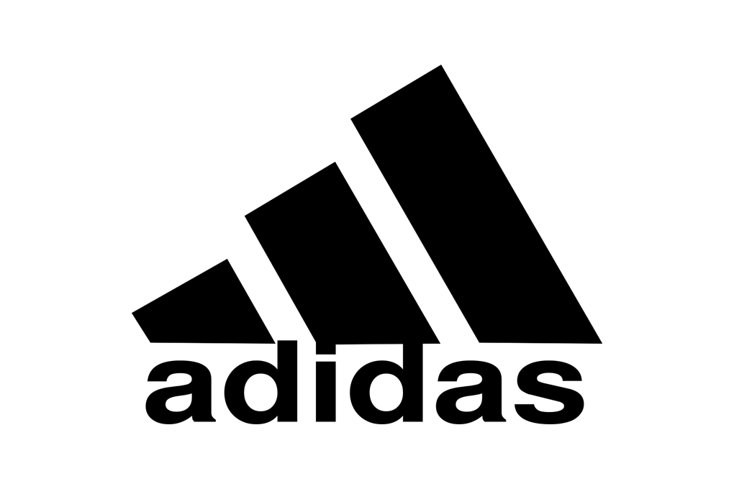
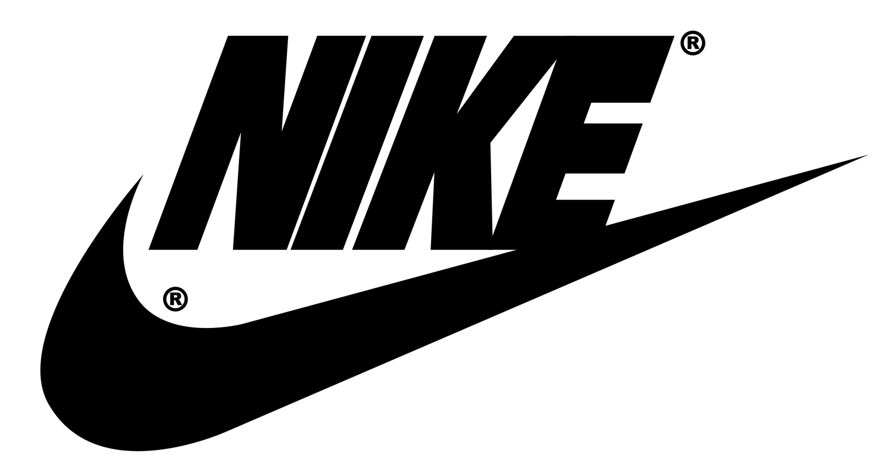
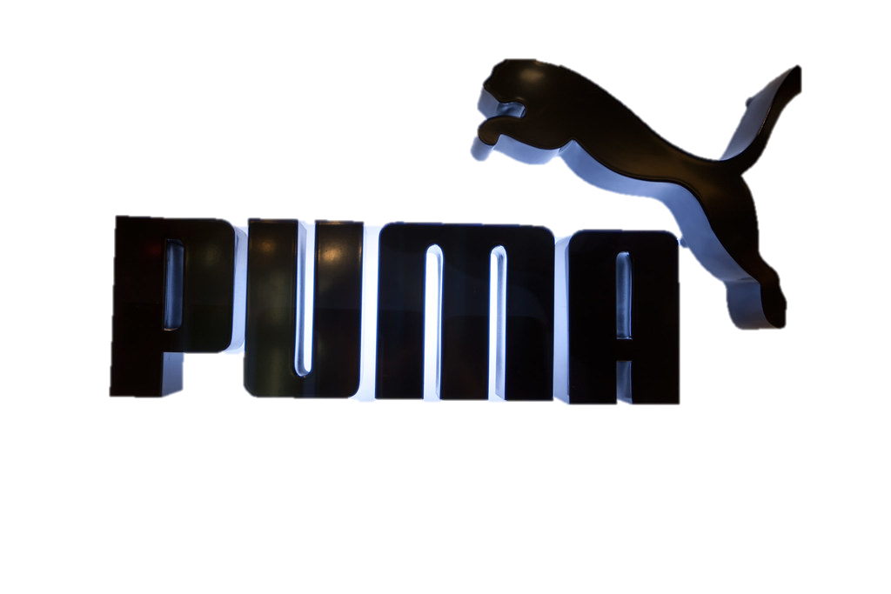
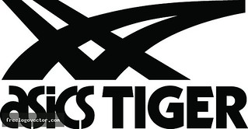

ASICS standing is as a brand used when
In true sport while keeping in mind one’s
performance
ASICS believes in design that are performance oriented and high tech
Many of ASICS consumers are serious sports enthusiast who value performance than style
True Sport
High Technology
Serious running
Fun
Performance
Performance oriented design
Protects feet
Style oriented design
Boost performance
Lifestyle
Low Technology
Casual running

Slide 12
ASICS stand as high-priced brand which determines social standing of a person as it
Perceived as highly expensive in the market
Asics stands as a high-quality innovative brand in the market, brings innovation to its products while keeping the product quality at priority
Asics stands as Unique brand that motivates its consumers to do better, to win in whatever field they choose to run at
Shows social standing
High Quality
Comfortable
Highly priced
Affordable
Casual
Give popularity
Innovative
Motivates for fitness
perception as cool
Low Quality
Unique

Slide 13
Defining asics (Current state)
For athletes looking to improve their performance in sports like running, tennis, rugby, and others, ASICS is the brand that best meets customer needs. These shoes not only
provide comfort to the wearer but also significantly contribute to performance improvement thanks to their gel-based technology, which can be customised to the individual
needs of the wearer thus making sporting easier.
Sports made easy with ASICS.

Slide 14
PART - B

Slide 15





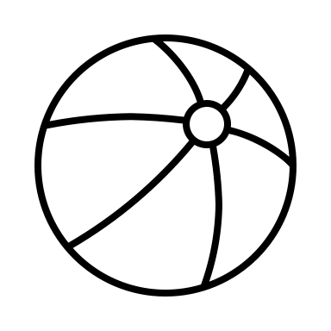

Identify OUR ASICS COMMUNITY
SKILLED EXPERTS Sports are an important part of who I am. It is a way to develop new skills and to be an expert. | UNLIMITED COMPETITORS Sports are extremely important in my life. It is a rewarding way to stretch my limits and to achieve my goals | PASSIONATE PLAYERS Sports are an exciting way to completely let go and really enjoy the moment, preferably with others | SOCIAL EXERCISERS Of course, you look after yourself with sports, but it’s also a fun way to have a great time with others | HEALTHY RELAXERS To me sports are part of a healthy lifestyle. Its good for my body and mine and helps me to relax | THE FUN RUNNERS I like to wear the shoes that boosts my confidence, is comfortable and give good feels | THE YOUNG ROCKERS I like to wear the shoes that brings out my cool personality, a stylish shoes that makes me stand out
RUNNING When I am running, I have a specifically developed program to help me focus on improving my running technique. | RUNNING When I am running, I constantly want to improve my time. Just running for the sake of it is not for me | RUNNING Running is a great way to let go. When running I really enjoy the change of scenery and the environment | RUNNING I like to run with friends or a running club. It is often more a social thing. When my friends can’t make it, I often don’t go either | RUNNING Its not that I am a big running fan, it just helps me to relax, and it is good for my body | RUNNING Its not something I do daily but yea sometimes I run casually for events with friends just to have some fun | RUNNING Not really enjoy running but I walk and go to a lot of places where I need comfortable shoes
SUMMARY : Till now we have been an established brand amongst skilled experts and unlimited competitors, we seek the remaining segment to become the part of Asics community.

Slide 16
Criteria/Market | Do we have a strong hold of them? | Is our brand personality appealing to them? | Is this a profitable target audience | Can they be exploited further? | Will they help us expand our business | Does this group help us align with our goal | Is this group approachable? With the current Asics brands? | Does competitors are have strong hold of this group? | Summary
Skilled Expert | Yes, Asics innovative technology is appealing for people looking to perform the best | Yes, the functionality and technology Asics shoes offer does appeal to this audience | Yes, this group is a loyal group to Asics. It is a valuable resource | No, we already have strong position here. | No, this audience limit us to providing our products for limited people | No, does not help with expansion of market | Yes, the image Asics has this group definitely approachable | No, Asics believe that it has a strong positioning with this audience | This is the area that Asics has a strong hold, it can be maintained
Unlimited Competitors | Yes, Asics has strong hold of people looking to perfect their running skill | Yes, the quality and comfort appeal to these consumers | Yes, the positioning of our brand is strong among this group | Yes, somewhat they can be exploited however this group also do not have much to offer | No, this audience limit us to providing our products for limited people | No, does not help with expansion of market | Yes, the image Asics has this group definitely approachable | Yes, however Asics is also a strong contender | This is the area that Asics has a strong hold, it can be maintained
Passionate Player | No, Asics have some hold of this group however other shoe brands have access to the group | Yes, Asics shoes quality and comfort can sometime persuade these consumers | No, Asics is not popular here hence not gained much profit from this group | Yes, they can be further reached out however the competition is fierce here. | No, this area has strong competition with well established brands. It can be risky and positive outcome is not guaranteed | Yes, but a challenges poses as in how far Asics can go to compete and will it be worth it | Yes, this group is approachable however again the hold of competition is strong here | No, the market is shared among giants. Asics is one of them | This group has a fierce competition and less requirement for Asics quality shoes
Social Exercisers | No, Asics have some hold of this group however other shoe brands have access to the group | No, these is some possibility however maximum of these groups have adopted other brands | No, high competition from other brands has substituted Asics | Yes, this is a broad audience that is growing we can definitely reach out | Yes, however this group has product substitution challenge. A lot of Asics resources will have to put to use | Yes, but a challenges poses as in how far Asics can go to compete and will it be worth it | Yes, this group is approachable however again the hold of competition is strong here | Yes, Nike and Adidas brands have strong hold here | This group includes entry of lot of local products, Asics can penetrate the market with mid-tier shoes
Healthy Relaxers | No, Asics has poor hold of this audience, its an opportunity to explore | No, these audience are not that aware of the Asics brand | No, high competition from other brands has substituted Asics | Yes, this is a broad audience that is growing we can definitely reach out | Yes, definitely can help expand Asics boundaries | Yes, it give opportunities and areas to explore | Yes, this group is approachable however again the hold of competition is strong here | Yes, brands like Puma have an extra share of this market | Asics comfort shoes can penetrate this market
The Fun Runners | No, Asics has poor hold of this audience, its an opportunity to explore | No, the fun runners are generally either price sensitive or not accustomed to the Asics brand | No, high competition from other brands has substituted Asics | Yes, this is a broad audience that is growing we can definitely reach out | Yes, this a customer Asics knows a little about it will be a challenge but worth a shot | Yes, it give opportunities and areas to explore | Yes, with tweaking the 4ps we can approach this audience | Yes, stylish brands that provides comfort at reasonable price has advantage | Asics new shoe line can be used to drive profit and expand business
The young rockers | No, these audience do not find Asics shoes appealing or stylish | No, these audience do not find Asics shoes appealing | No, Asics to these group have not been able to yet established | Yes, this is a broad audience that is growing we can definitely reach out | Yes, this a customer Asics knows a little about it will be a challenge but worth a shot | Yes, it give opportunities and areas to explore | Yes, with tweaking the 4ps we can approach this audience | Yes, stylish shoes resonating with the young minds have advantage | Asics new casual shoe line can be used to drive profit and expand business it’s a big market to grow

Slide 17
WHERE ARE WE STANDING FOR EACH TARGET AUDIENCE?
True Sport
High price
popularity
Serious running
Performance
technology
fashion
Casual running
leisure
Lifestyle
Low price
comfort
Skilled Experts & Unlimited competitors : Asics is
The no.1 choice when consumer focus is enhancing
Their performance
Passionate Players, Social exercisers, Healthy Exercisers : Asics tiger is also can be placed in this market but is not perceived as what we want the consumer to perceive as
The Fun runners & the young rockers : For the young audience we have a long way to go to change their perception

Slide 18
WHERE WE want to STAND FOR our target audience
comfort
High price
popularity
Serious running
Performance
performance
style
Casual running
Leisure
Lifestyle
Low price
comfort
Social Exercisers : We want make asics a more of
Friendly brand to these group
Healthy Relaxers : We want this group to accept asics true performance as an alternative to competitors
The Fun runners & the young rockers : we want new perception for Asics Tiger and Onitsuka Tiger
To become popular and appeal to this group

Slide 19

Let’s Analyze how the new positioning will look for us
Criteria/Market | Can we own this space | Can we go toe to toe with Nike and other brands? | Is this how our target market sees us? | Is it strategically relevant | Will this help us expand our market | Is it a suitable long term goal | Will this drive profit | Summary
ASICS as a casual running | Yes, we have seen a trend where social exercisers can opt comfort over price | Yes, our shoes have succeeded in running and other sports, we can compete here as well | No, not yet however we want to change that | Yes, it has some challenges and risks but we would like to stretch here | Yes, the casual running market is on a rise | Yes, the casual running market is on a rise, it is appropriate to take action now | Yes, the casual running market is on a rise, it will drive profit for us | Asics potential to grow in the targeted market is very much positive, keeping in mind the competition and putting our shoes in new place will attract some risks however we can expect Asics products to shine in the market.
ASICS as fun (mid tier) | Yes, it might take a while to change perception but it is possible | Yes, even though we have fierce competition we can make it work | No, we are seen more as performance driven | Yes, it has some challenges and risks but we would like to stretch here | Yes, the mid – tier market is on a rise | Yes, the casual running market is on a rise, it is appropriate to take action now | Yes, we can own the mid – tier market
Asics tiger as popular brand | Yes, there is a ton of competition but it is possible | Yes, even though we have fierce competition we can make it work | Yes, in some aspect however this idea is not that popular | Yes, it is the need of the hour | Yes, Asics tiger target audience need to converted to Asics consumers | Yes, trends sees popularity of certain shoe brands makes them the choice | Yes, popularity matter to most of the young audience, we can target this market
Onitsuka Tiger as stylish brand | Yes, we were successful in Europe, we can certainly own this space | Yes, however for Onitsuka a different competitor list be needed | Yes, in some regions however its not a popular opinion | Yes, it is important for us | Yes, for people who enjoys looks we want to become the brand for them | Yes, we need to set a certain positioning for our products | Yes, we can drive profit from the target audience

Slide 20
What the benefits mean?
Criteria/Market | Do we have reason to believe | IS it valuable to the target audience | Can we own this benefit | Does this align with our value | Can competitor own this benefit | Does it align with our brand image | Is it strategically relevant | Summary
Improves performance | Yes, Asics technology gives its users the edge over others | Yes, the serious runner love the shoes | Yes, we can own this benefit very well | Yes, this is in fact one of our core values | Yes, competitor can own this benefit | Yes, Asics brand image is providing quality shoes | Yes, it will help us move forward | ASICS can and will own these functional and emotional benefit for our target consumer. It is the core value of Asics hence it will try to maintain and boost these benefits
Provides Comfort | Yes, the shock absorbing tech gives the consumer comfort | Yes, fun runners love how Asics keep their feet safe and pain free | Yes, this is something that very few shoes offer | Yes, Asics believe in enhancing performance without giving pain | Yes, many competitors have this benefit but we can do better | Yes, Asics brand image is providing quality shoes | Yes, targets the fun run segment
Works better for consumer (High tech shoes) | Yes, Asics core value is providing the best innovative for consumer needs | Yes, the Asics shoes are innovative for consumer needs | Yes, our technology stands tall among all | Yes, Asics products always enhances the performance | No, Asics gel tech, shock absorbing shoes have not been able to replicated by competition | Yes, Asics is a brand committing to working for the consumer | Yes, it will build confidence of audience towards Asics
Boosts Confidence | Yes, Asics shoe designs and brand style can give our consumer the feel of confidence | Yes, the audience wants to feel confident | Yes, our product will overpower every other brand | Yes, Asics value is customer satisfaction | Yes, many competitors have this benefit but we can do better | Yes, our brand screams confidence | Yes, It is important to make consumer feel confident to comeback

Slide 21
QUICK RECAP
Our target audience are social exercisers, Healthy relaxers and young rockers
We want a add new casual, fun, popular image to our brand but without compromising on our brand image that we have maintained till date as it is our core resource and value we give to our consumers.
The Asics brand helps consumer feel confident on their feet, improves their performance basically make them better at whatever they choose to be.
What we want to be know for
ASICS –
For the who believe in the power of running while enjoying the scenery, ASICS True sport shoes understands how important it is for you to take care of those feet so that the explorer in you runs beyond the boundaries the world has set for us. ASICS true sport uses the thick shock absorbing soles that is meant to take care of the feet that run.
ASICS TIGER –
For the passionate fashionable you, ASICS TIGER is the brand that has the latest, newest design which does not only brings comfort to your feet but also makes you look good
Onitsuka Tiger –
Wants to keep yourself updated with the fashion and trends? Onitsuka Tiger is here to take care of it. Onitsuka Tiger from ASICS gives you the trending fashion look that will turn heads just to see that design, look, quality of the Onitsuka in your feet
“Brings passion to light”
2024-01-17
21

Slide 22
REFINING of PRODUCT CATEGORY
Value | Products | Target audience
High Performance Shoe | Asics true performance - The Technology used in Asics true performance shoe protects the feet and keeps it safe while a runner enjoys the running These shoes has the best technology that can take one efforts to next level Asics true performance is the star product we should leverage it to broader audience | Social Exercisers, Healthy relaxers
Stylish | Asics Tiger and Onisuka Tiger – The look, design and luxury while giving comfort to the feet These products are focused on luxury and lifestyle thus suiting the target audience The young rockers are more into shoes that give give personality to them | The young rockers
Running | ASICS true performance – The comfort Asics give, the shock absorbing feature while running Asics true performance is ideal for shock absorbing thus improving running performance Asics true performance can also make running comfortable rather than painful | Social Exercisers
Comfort | ASICS true performance – The comfort Asics give, the shock absorbing feature will cater to this market Asics true performance can also make running comfortable rather than painful | Social Exercisers, Healthy relaxers, The young rockers
Price Point | ASICS True performance – The true performance shoe has the potential to grow with correct marketing regardless of its price point The right marketing can bring these audience to Asics | Social Exercisers

Slide 23
ALIGNING PRODUCTS and the brand
Criteria/Market | Is this how the current positioning of our brand is | Is this how the Asics product organized | Does it make sense to our target audience | Does the parent brand influence the product brand | Do their target audience overlap | Does it enable us to compete better | Is it easy to communicate | Can we consistently deliver it | Summary
Branded House | No, we have Onitsuka Tiger that has not resonate with Asics name | No, Asics name does not go with all its product | Yes, it can make sense since they can connect tiger strips to Asics | No, the product go beyond the parent brand | No, Asics audience have a vast difference in various regions | No, with one name we can confuse the audience | No, this will further increase3 confusion | No, we already have products that do not carry the Asics name | We can align Asics as an endorsed brand, which means we can come up with multiple products in multiple areas while keeping the brand name intact.
Sub - brands | Yes, ASICS logo can be seen in all its products | No, Asics product cannot be connected to Asics | Yes, the audience can connect the strips to Asics | Yes, with quality functionality and logo | No, Asics audience have a vast difference in various regions | Yes, the Asics name can push the sub brands image | Yes, the products can be qualified as Asics sub brands | Yes, we bring in products and keep the logo as it is
Endorsed Brand | Yes, ASICS logo can be seen in all its products | Yes, the logos can go back to the parent brand Asics | Yes, the strips can directly connect to Asics | Yes, with quality functionality and logo | No, Asics audience have a vast difference in various regions | Yes, the Asics name can push the sub brands image | Yes, the products can be qualified as Asics sub brands | Yes, we can bring in multiple products, even with different names and keep the logo
House of brands | No, the logo gives away the separate identification of these brand | No, all the products has the same logo that connects them to one brand | No, the products do not have their individual separate identity | Yes, with quality functionality and logo | No, Asics audience have a vast difference in various regions | No, separate identity will also mean separate promotion marketing and rebuilding image of our placed products | No, creating a separate identity for each product will cause difficulty since they are connected with Asics logo | No, we need to keep the asics logo intact as it is what makes the brand stand out

Slide 24
RECAPTURING ALL OF OUR DECISIONS
3 Target audience for 3 different Asics products – Social Exercisers, Healthy relaxers & The young rockers
We want to change the product perception that is “Asics just for serious runner” to other target consumer friendly that is fun runner, style freaks
Again, our positioning need to changed to more consumer friendly rather than asking for perfection we want to tell them to be comfortable and we will protect
We have differentiated all our products and aligned with the target audience we think will fit the customer profile for the product category

Slide 25
Evaluation of our decisions in the 2022 market
People love style more than anything else, Asics Tiger and Onitsuka tiger can be leveraged
After covid people have been wanting to travel more, what shoe is better than the one that will provide them comfort and keep their feet safe
2022 recession has seen many people spending less, However an Asics shoes lasts almost a lifetime therefore the quality and functionality we provide checks out and people still go for our brand
What happened in the market since 2015….
#More interest in style
#Younger target of our becoming adults
#Customer expectation from Asics have increase in terms of quality delivery
#Asics remain the no.1 quality and functionality shoe provider
#No.1 choice for various sports (Rugby, golf, tennis, cricket, volleyball)
# Sports enthusiast have also increase thus widening Asics target audience

